Slide 1

Autodesk Revit ® 2011 Revit API Intro. Hands on Training (Draft)
Adam Nagy
Developer Technical Services

Slide 2
Revit API Intro.
Revit API fundamentals
Revit Add-ins: external command/application, attributes, add-in manifest and object model
Representation of Revit elements
Element iteration, filtering and queries
Element modification
Model creation
Exercises:
Lab1 – “Hello World”
Lab2 – DB element
Lab3 – element filtering
Lab4 – element modification
Lab5 – model creation

Slide 3
Revit Add-ins
To Do
Slides to explains each topic comes here. E.g., IExternal command, IExternal Application, Attributes, Manifest file.
Make is simple as you can explain these while showing demo.
Possibly after a set of slides, you can link to the lab1, lab2, etc.

Slide 4
Revit Intro Labs Exercises
Exercises to learn the fundamentals of Revit API:
Lab1 – Hello world: external command and application
Lab2 – DB element
Lab3 – element filtering
Lab4 – element modifications
Lab5 – model creation
(Lab6 – shared parameter, slightly extended model creation category. To Do)

Slide 5
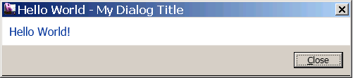
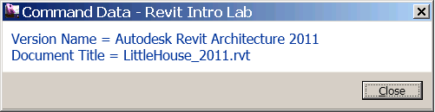
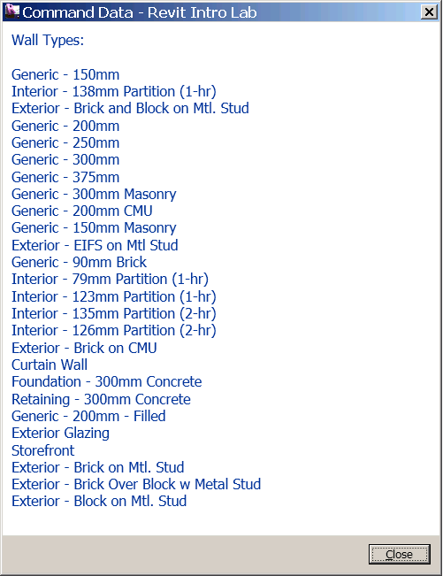
Lab1 – Hello World: external command and application
Objective: learn THE basics of Revit API.
Implement an external command/application
Implement an external application
Apply attributes
Write an add-in manifest file
Access to the Revit object model
Classes and methods:
IExternalCommand
IExternalApplication
OnStartup()
OnShutdown()
Attributes
TransactionMode
RegenerationOption
ExternalCommandData

Slide 6
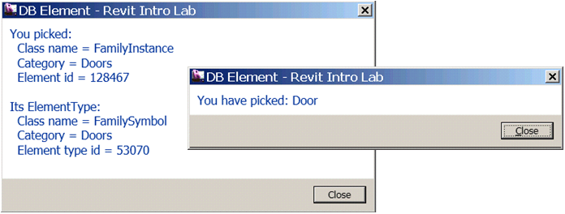
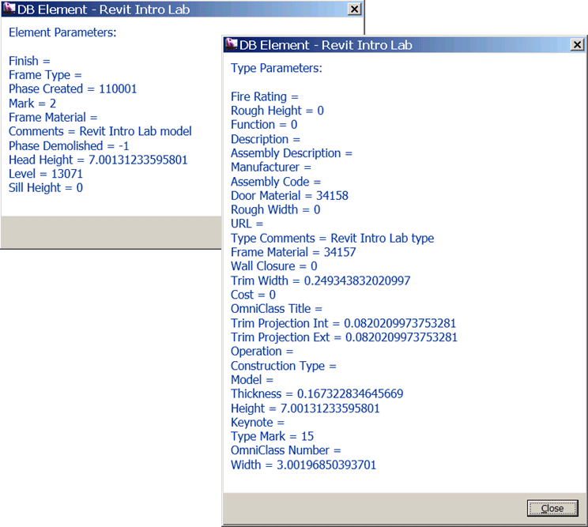
Lab2 – DB Element
Objective: learn how an element is represented in the Revit and how to retrieve information about it
Identify element
Retrieve:
a set of properties of an element
a specific property of an element
location information
geometry information
Classes and methods:
elem.GetType(), .Category(), .Id(), .GetTypeId()
Wall, Floor, RoofBase, FamilyInstance
WallType, FloorType, RoofType, FamilySymbol
Parameter
Location, LocationCurve, LocationPoint
GeometryElement

Slide 7
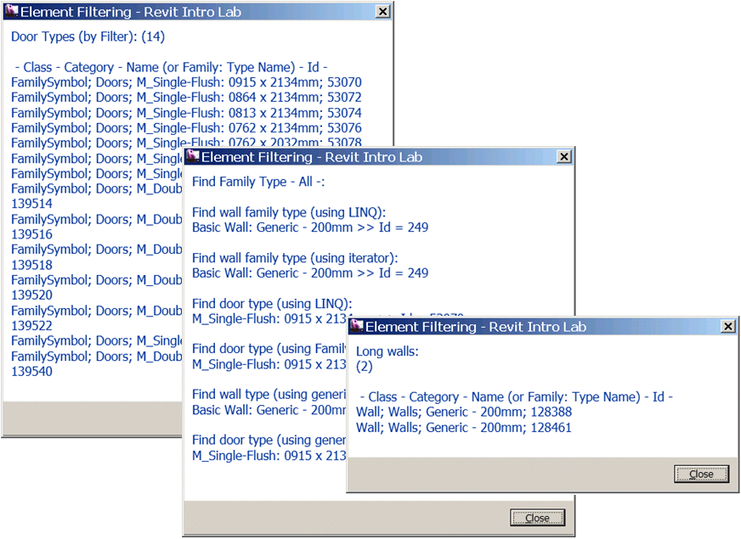
Lab3 – Element Filtering
Objective: learn how to filter elements
Retrieve family types
Retrieve instances of a specific object type
Find specific family type
Find specific instances
You will need lots of hands-on exercise for filtering
Classes and methods:
rvtDoc.WallTypes
FilteredElementCollector
ElementClassFilter
ElementCategoryFilter
ElementParameterFilter
FilteredElementIterator
LINQ query

Slide 8
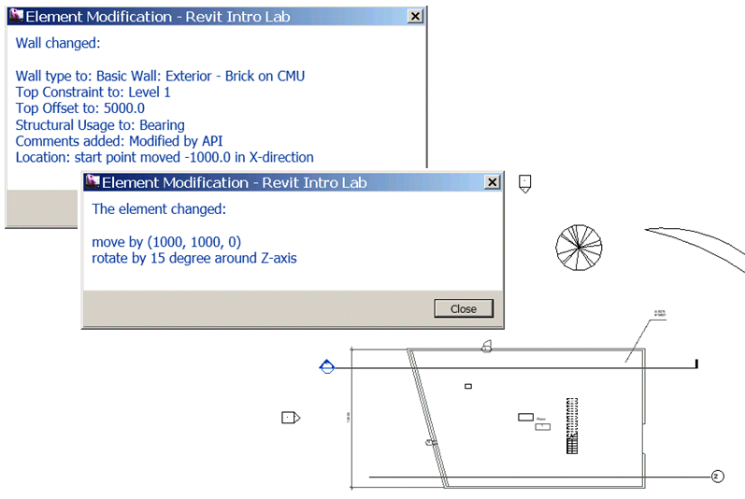
Lab4 – Element Modification
Objective: learn how to modify elements
Modify an element’s properties, parameters and location
Modify an element using Document level methods
Classes and methods:
aWall.WallType, aDoor.Symbol
aWall.Parameter( BuiltInParameter.WALL_TOP_OFFSET).Set(14.0)
LocationCurve
LocationPoint
rvtApp.Create.NewLineBound(pt1, pt2)
rvtDoc.Move(), .Rotate()
rvtDoc.Regenerate()

Slide 9
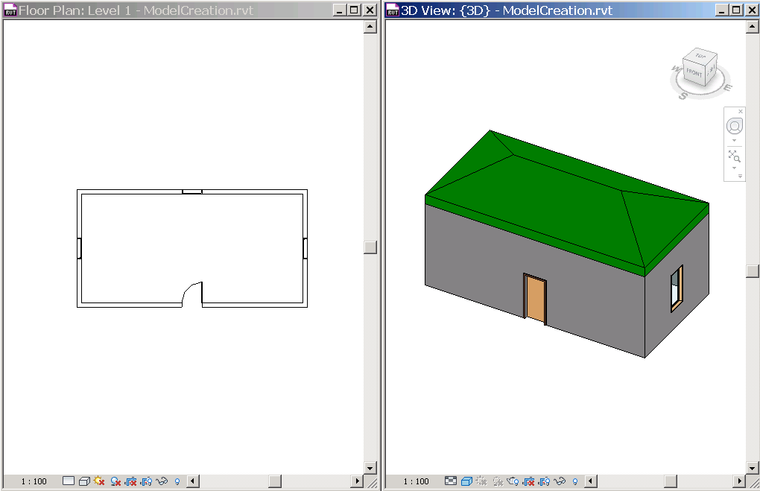
Lab5 – Model Creation
Objective: learn how to create a Revit model
Create instances of architectural elements
Classes and methods:
rvtDoc.Create.NewWall()
rvtDoc.Create.NewFamilyInstance()
rvtDoc.Create.NewFootPrintRoof()
rvtDoc.Regenerate()
rvtDoc.AutoJoinElements()

Slide 10
Revit API Getting Started Samples
[You can list some samples that you can recommend as a good starting point here]

Slide 11
Where do we go next
Revit UI Labs

Slide 12


